Slide 1
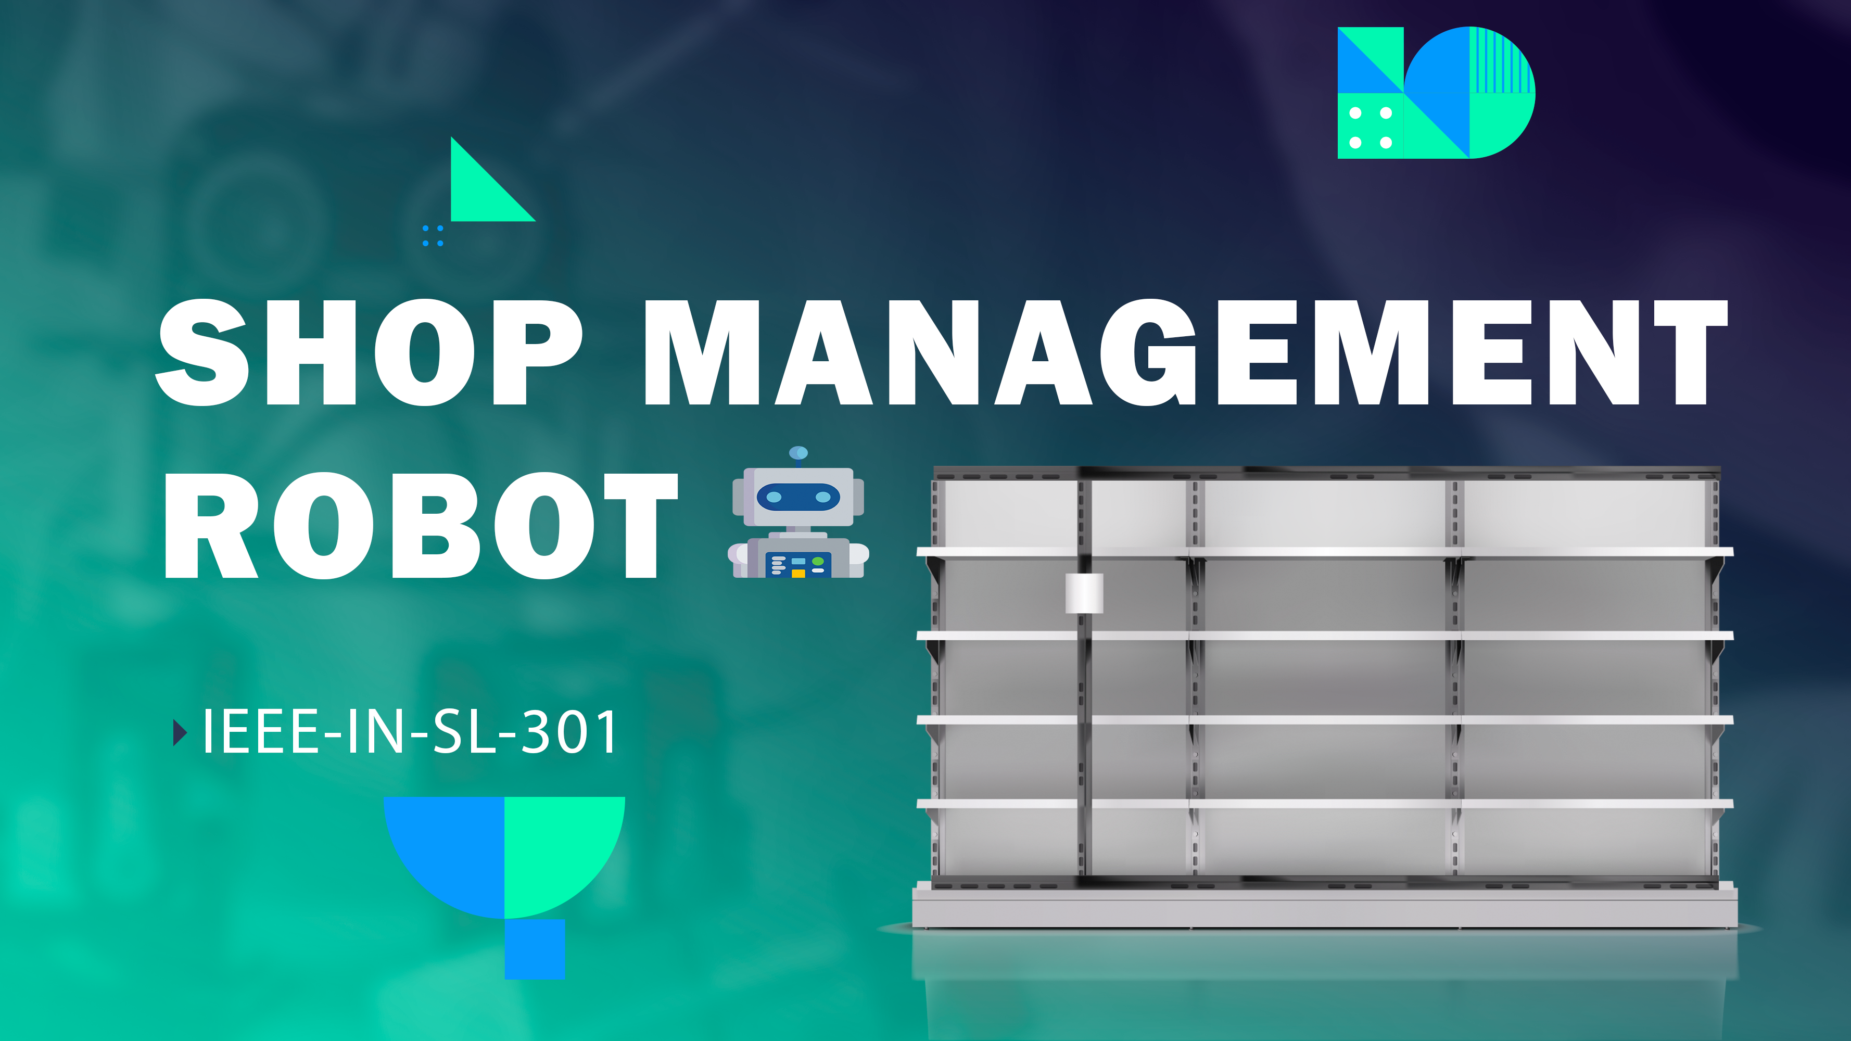
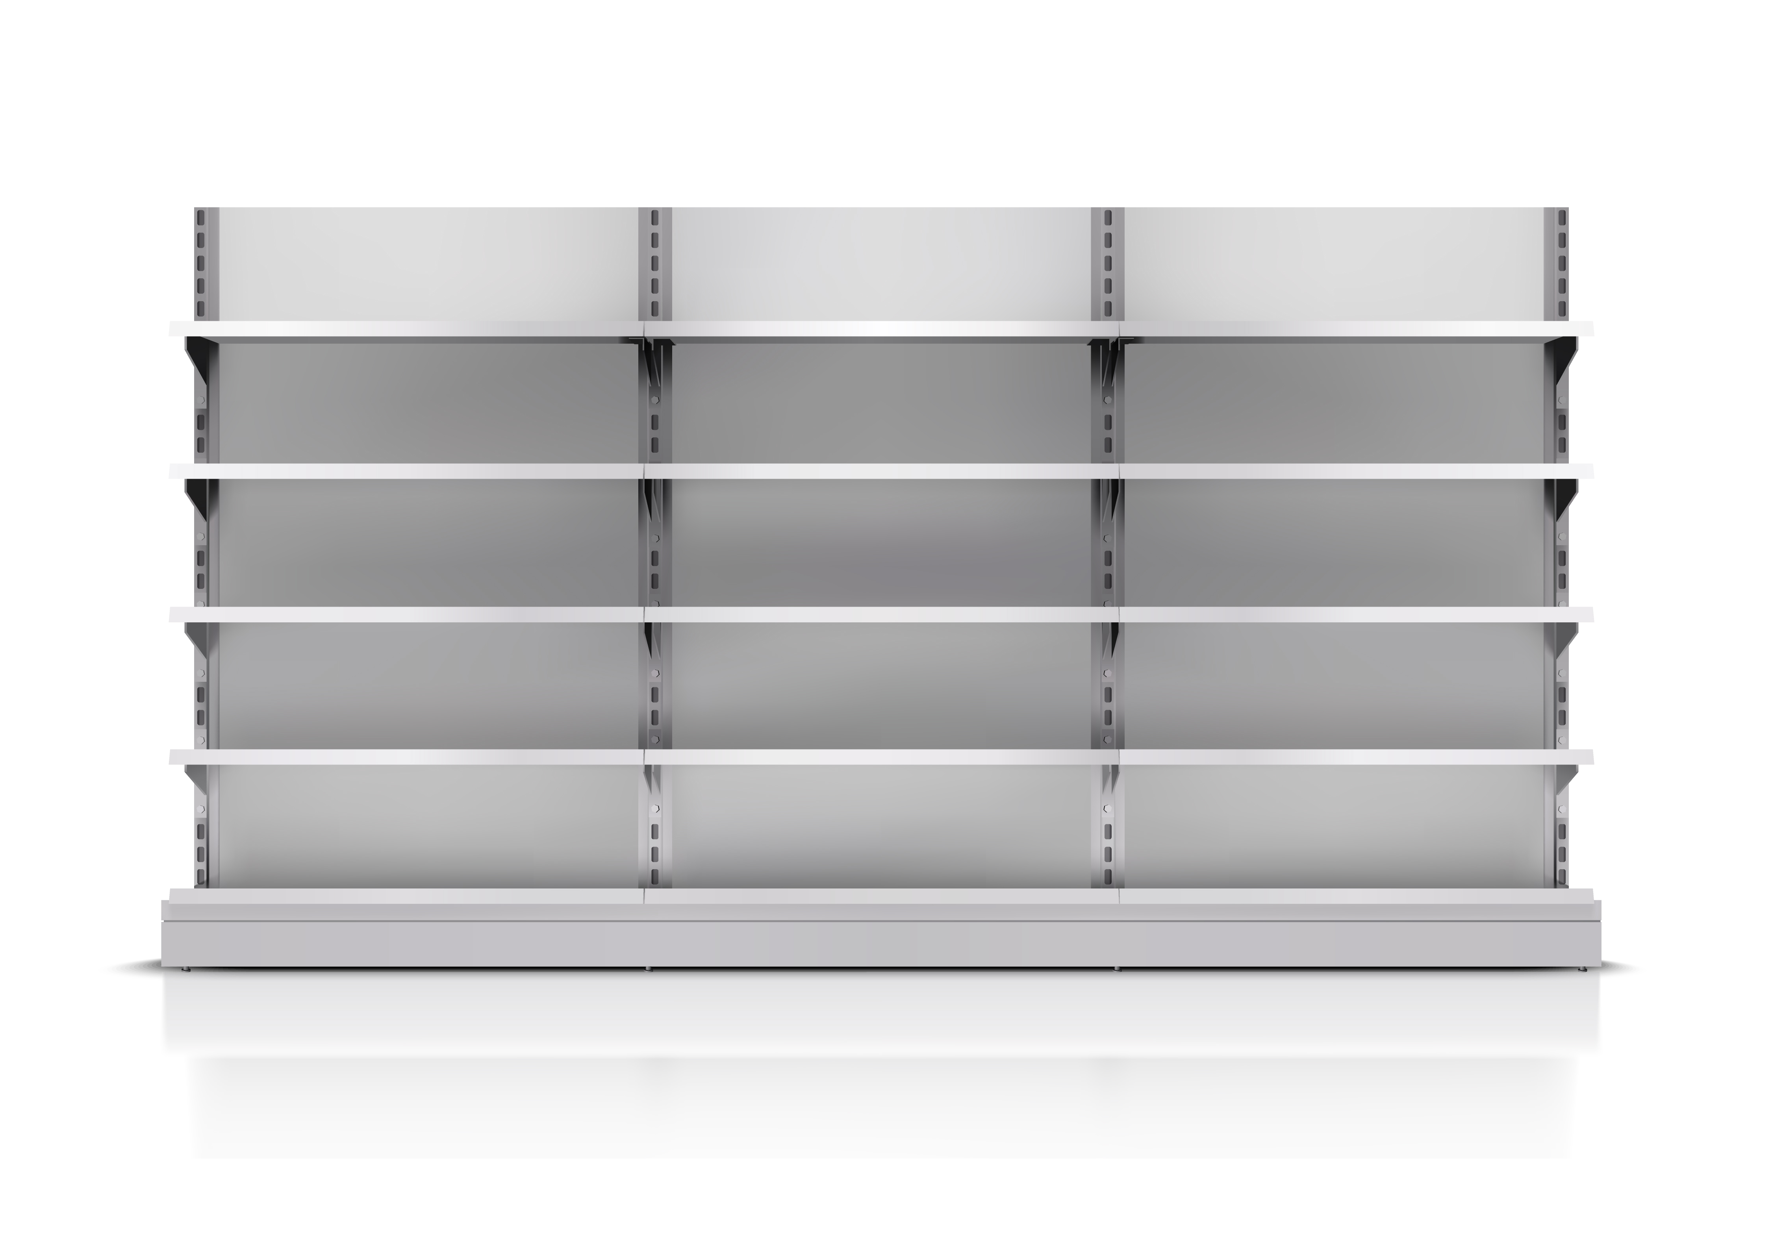
SHOP MANAGEMENT ROBOT
IEEE-IN-SL-301

Slide 2

Introduction
In the modern world robotics is using for various human activities. Think if we build a robot for small scale entrepreneurs. That may be a huge step for the entrepreneurs and their businesses. In here we are planning to build a robot which can be fixed easily in a shop to package things ordered by a customer. This is an unmanned process which is more efficient than doing by human hands

Slide 3
Problem
In a supermarket customers needs to walk in a big area to find the goods they need and it is time wasting for busy people. As the Covid-19 pandemic continues to keep people indoors and away from public places, the need for an unmanned ordering system is increasing.
Also, retailers are looking for a way to operate in a small space so they can build their shops anywhere, closer to the customers and to reduce their operation costs and gain more profit.

Slide 4
Solution
We are building an automated system which can select and pack the things ordered by a customer in a shop. It can operate in a small space, more efficiently than a human. Once the packaging has done, people can collect their package from the counter, pay and leave.
As we continue our business for several years we will develop an app to order goods online and once the packaging has done by the robot, inform a courier automatically to deliver the goods to the customer’s doorsteps.

Slide 5
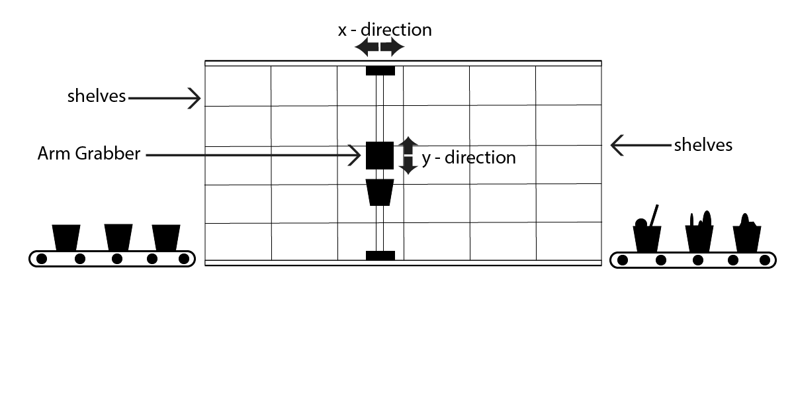
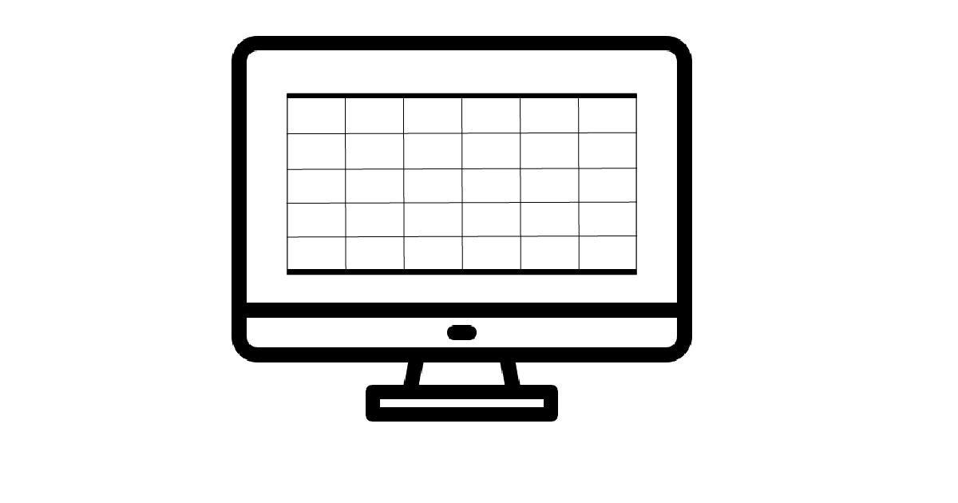
2D ROBOT
This robot collect the items which customer needs or items which input by the user into a basket and bring that basket to customer or user. This robot can move only 2d area. Arm Grapper can grab a item from the chosen cells of these shelves and put that on the basket which has fitted to the robot. we developing a software to customize those shelves by the customer in a virtual world. In addition to that we can develop a app or website which can order through online. Then we can use this concept to online warehouses also..
Real World Shelves
Virtual World Shelves

Slide 6

Competitive advantages
Currently there are no automated grocery stores or retailers in Sri Lanka. The reason behind this is business owners are not confident enough to switch for this method. So this is a good opportunity for us to introduce this automated retail store concept to the Sri Lankan market specially for mega malls such as One Galle Face, Marino Mall, Colombo City Centre, Kandy City Centre, etc. Wealthy people visiting these malls are keen to experience these kinds of new technologies only found in highly developed countries. So they will happily adapt this very convenient method of buying goods only available in few stores like Amazon and Walmart in USA and Inco in Denmark.

Slide 7

Market Potentials / Target Market
Our business model is B2B. We plan to sell our product to supermarkets, retail stores in mega malls and we plan to extend our service to online shopping stores by developing a new app which integrates our system with their online shopping apps or websites. If they need, we can design a complete online shopping app for them. We expect only 2-3 customers in the first year as this is a new experience to Sri Lanka. Then in the second year, we expect to reach to 10 customers. After 5 years we can sell our product to more than 100 stores around the country. We expect to begin partnerships with large supermarket chains such as Cargills Food City, Keells, Arpico Super Centre, Laugfs Super, Spar and Glomark so we can extend our business rapidly.

Slide 8
Business Model Canvas
Key Partners
Universities
Cloud Computing Service Provider
Raspberry Pi Service
Key Activities
Development of IoT hardware Development of embedded software, app and cloud Maintenance of Software
Product installation
Providing technical support
Value Proposition
We help retailers to operate their businesses in a small space. We reduce the operating cost of retailers by eliminating the need for human employees.
Our robot can operate 24/7 helping online stores to be open anytime of the day.
Lower time to operate allows more sales for a busy retail store. We can set up a whole new automated stores within few weeks
Customer Relationships
Product Website
Social Networks
Business Trade Fairs
Online Forms
Customer Segments
Supermarkets
Retailers in Mega Malls
Fulfillment Centres
Online Shopping Stores
Key Resources
Software and Hardware development team
Technical Consultants
Product Installation team
Financial resources
Key Resources
Software and Hardware development team
Technical Consultants
Product Installation team
Financial resources
Channels
Web sales
Personal relationships
Sales force
Cost Structure
Installation Cost Cloud Services (Monthly Fee)
Advertising Software and hardware development cost
Revenue Streams
Installation fees
Fee from additional services such as technical support
fund-raising

Slide 9
Revenue Models
We expect the cost of a unit to be Rs.70000 and we expect to earn money by installing the system, for maintenence of the system, for
providing technical support, and for some customers, monthly fee for developing and maintaining their online shopping apps. The installation
fee will range from Rs. 100000 to Rs. 150000 depending on the size and the requirements of the client. Build quality, speed, maximum permitted load, type of the robot arm will vary according to the price and the requirement.

Slide 10




Technologies used to build
Basically we are using Arduino as a microcontroller to develop this product. Then we suppose to improve the product with image processing. Therefore we will use RaspberryPi in the future. Four stepper motors and cable straps using for 2D movements. Servo motors and Stepper motors are also used for the ‘Arm Gripper’. We will first use the Arduino to control the performance of these motors. We will then further develop this circuit which create with our own design with ATMEL chips. Furthermore we hope to use image processing to properly identify the items on a shelf and put the item in the basket.In For image processing we use camera which mounted near the arm gripper and RasberryPi is used as the microcontroller for that operation. Visual studio is used to create software related to this robot. In addition , we hopen this robot is used for an online store and we are using IOT for that operation.

Slide 11
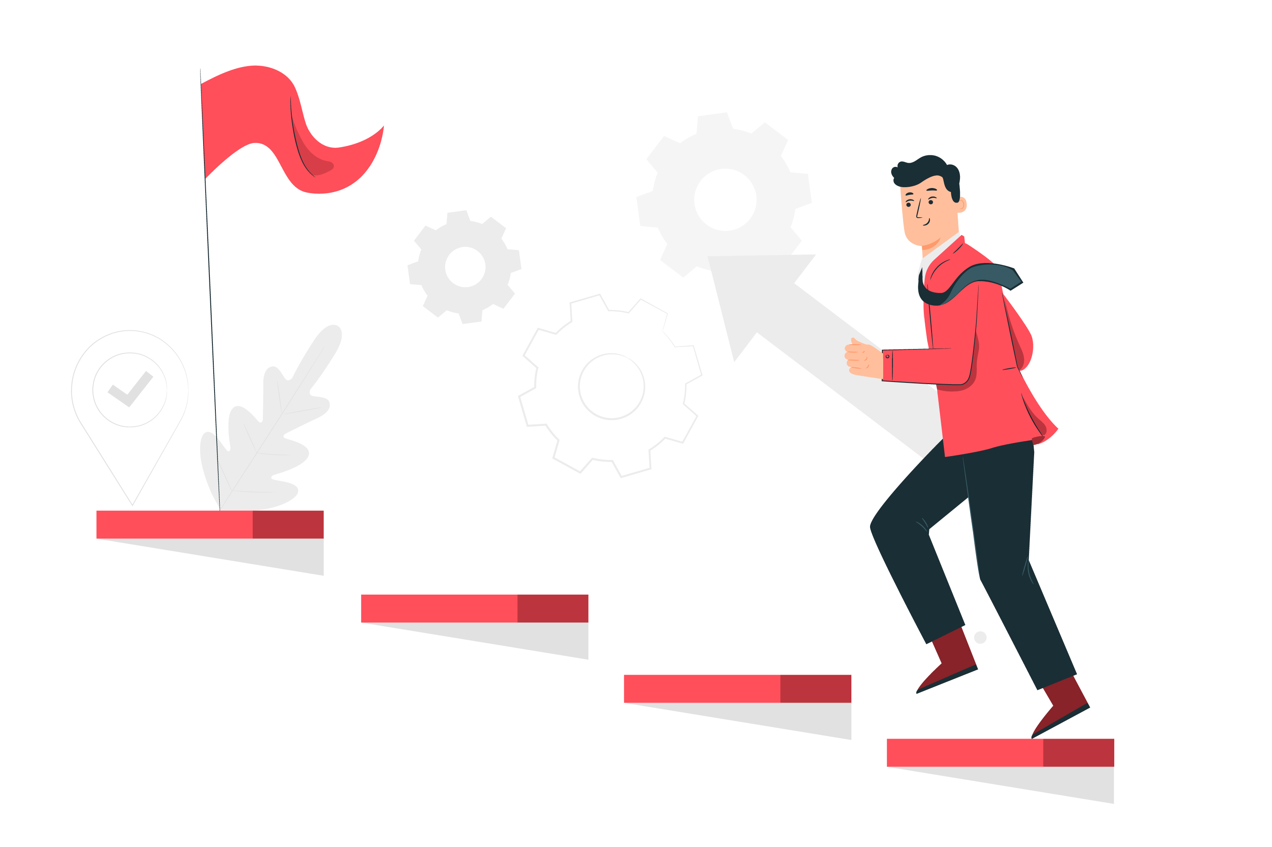
Progress as now
Our project is still at the ideathon level. To continue to the next phase of the project, we have gathered all the requirements from various stakeholders.

Slide 12
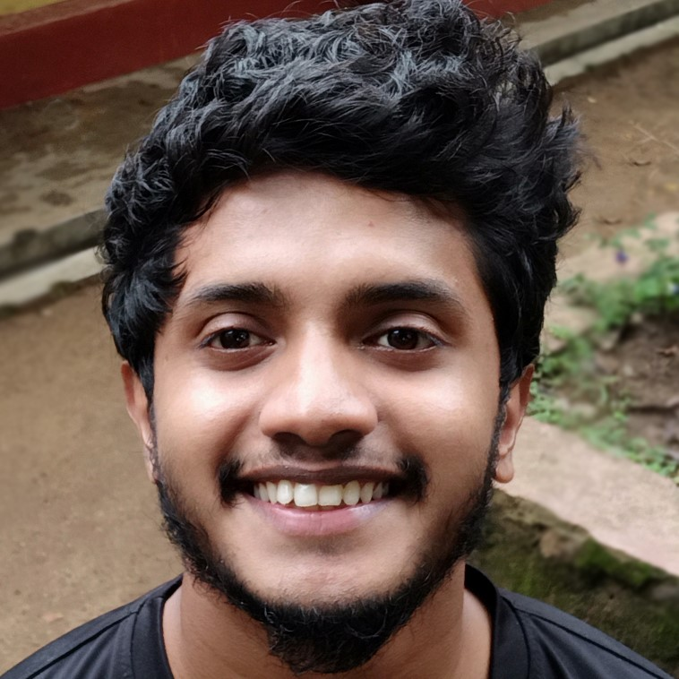
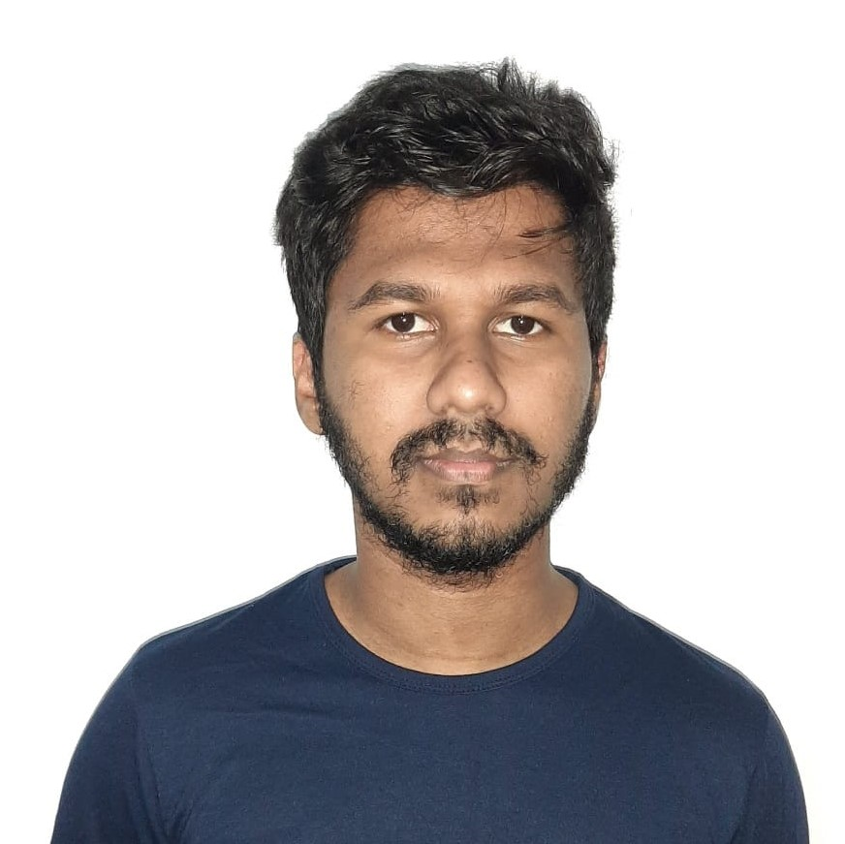

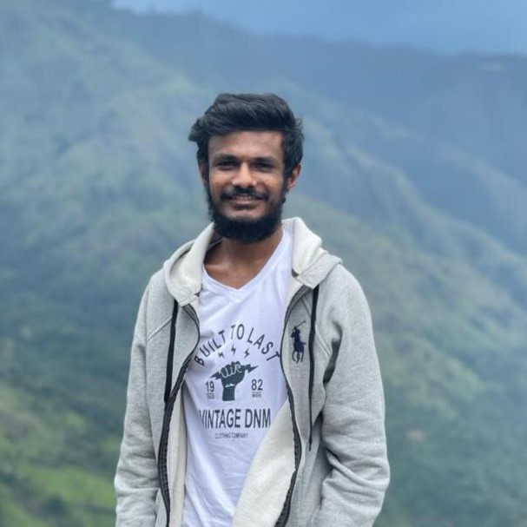

Our team
Jayashan bandara
University of Moratuwa
Team Leader
Ayesh bandara
University of Moratuwa
Business Model Creater
Pavara Nipun
University of Moratuwa
Presenter
Tharaka Dimalsha
University of Moratuwa
Software developer
Suraj Tharuka
University of Moratuwa
Marketing

Slide 13
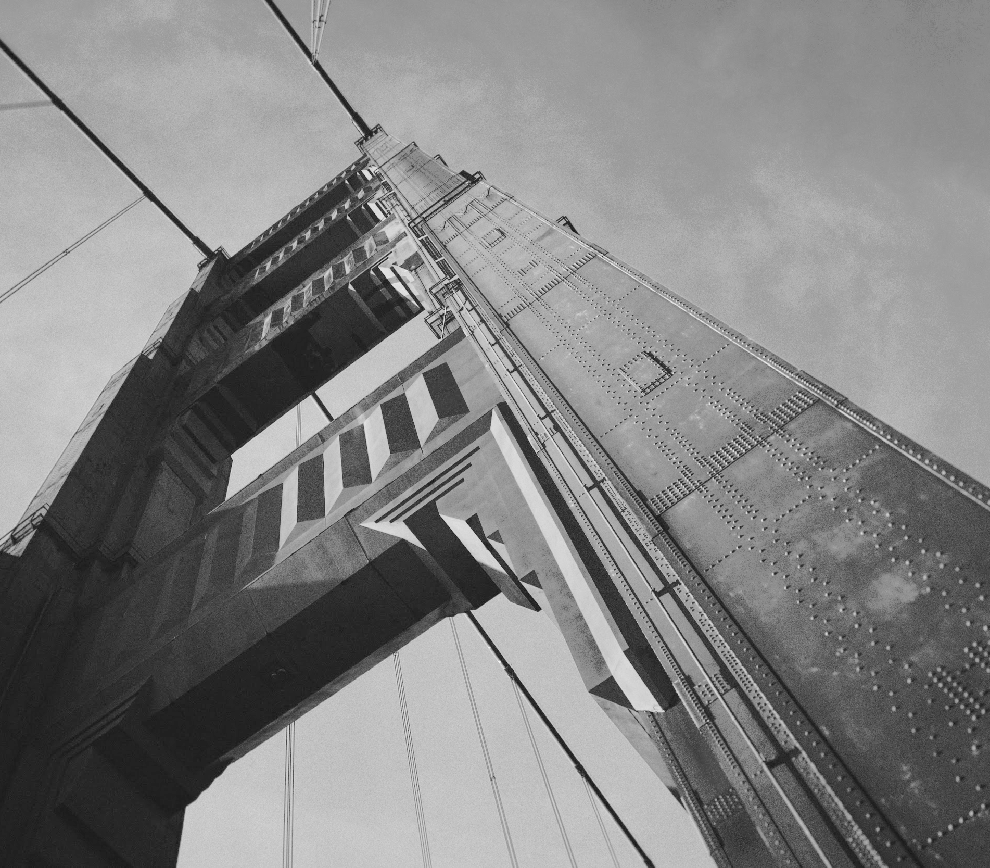
Thanks!
Contact us:
Jayashan - 071 187 3463
Ayesh - 070 108 4584
jayashannx12345@gmail.com
wrwmanbandara@gmail.com

